Slide 1


UK TRAIN RIDES
REPORT
P R E S E N T A T I O N

Slide 2

Team Members:
Mohamed Ahmed Aboelela
Mohamed Reda Ibrahim
Hossam Mohamed Hammad
Noran Mohamed Yassin
Amany Gamal Abozaid
Eman Ahmed

Slide 3
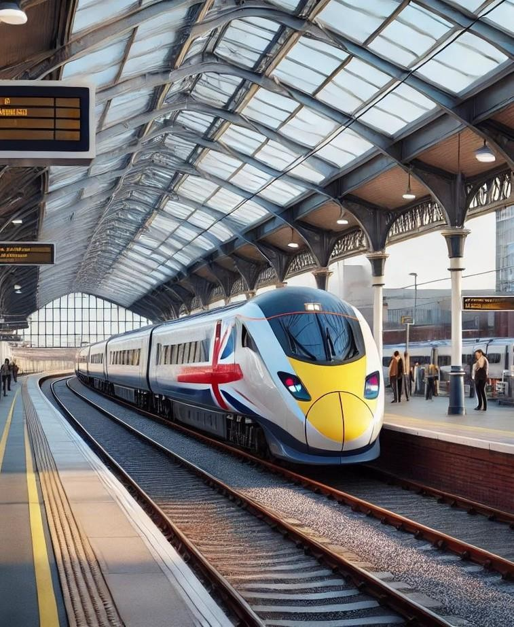
Introduction
The "UK Train Rides Report" project was developed to provide a comprehensive and detailed analysis of railway operations in the United Kingdom. This report is the result of a collaborative effort focused on
identifying operations, experience
and resolving critical the passengerissuesin train as well as optimizing

Slide 4
Project Phases
Questions
Data Cleaning
DAX
2
ETL
4
Normalization& Data Modeling
6
Visualization
1
3
5

Slide 5


Data Analysis Questions

Slide 6
Questions
§ Performance Analysis
What percentage of total trips were cancelled or delayed?
Which routes experience the highest number of delays or cancellations?
§ Revenue Analysis
Which Stations generate the most revenue?
What is the revenue loss due to cancelled or delayed trips?
Is there a seasonal or monthly trend delays, or cancellations?
§ Operational Efficiency
Are certain time periods (days of the week, months) more prone to delays or cancellations?
What are the average delay durations per route or trip type?
§ Comparative Questions
How do high-performing Stations differ from low-performing ones in terms of trips, revenue, and delays?
what is the trend of trip volume and performance over time — is it improving or declining?

Slide 7
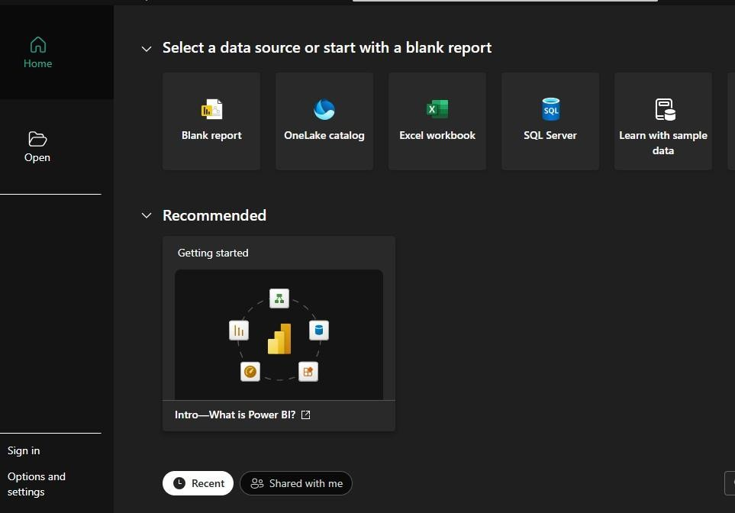
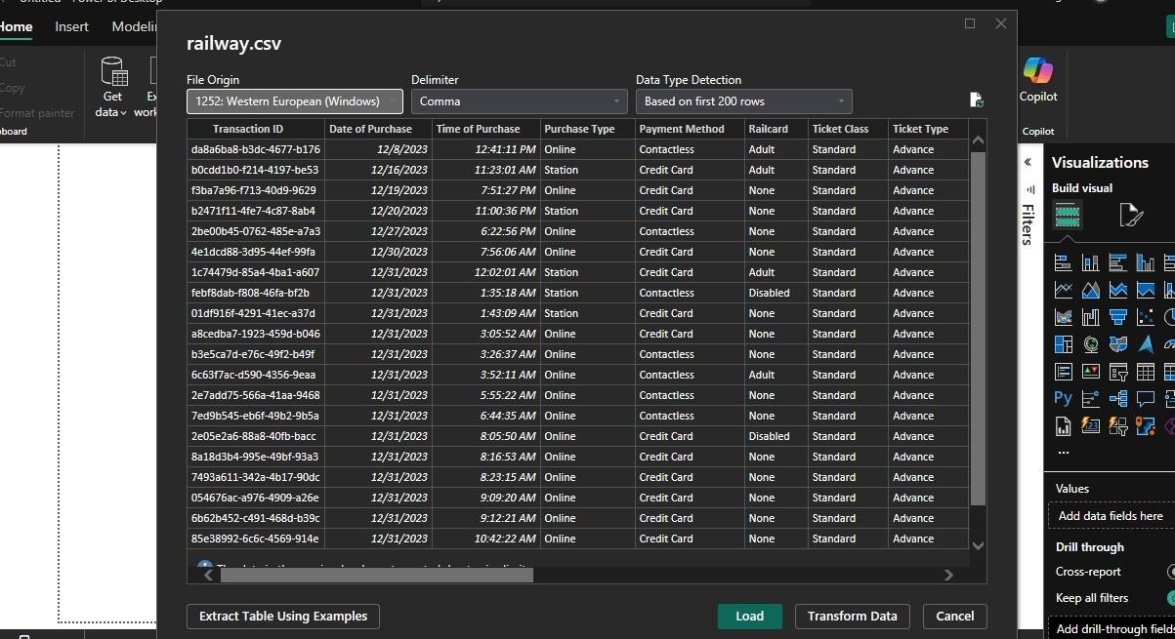
ETL

Slide 8
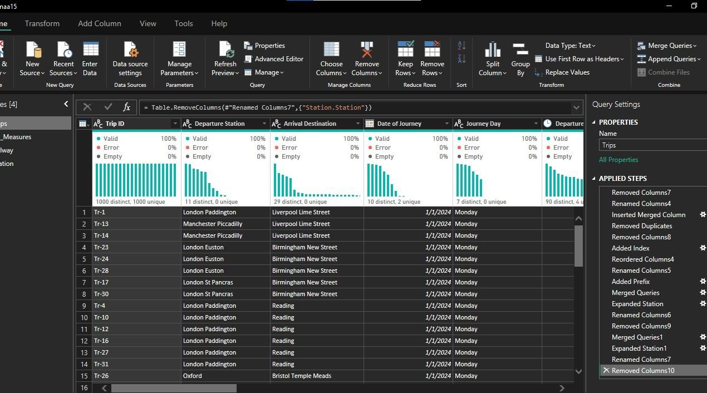
Data Cleaning

Slide 9
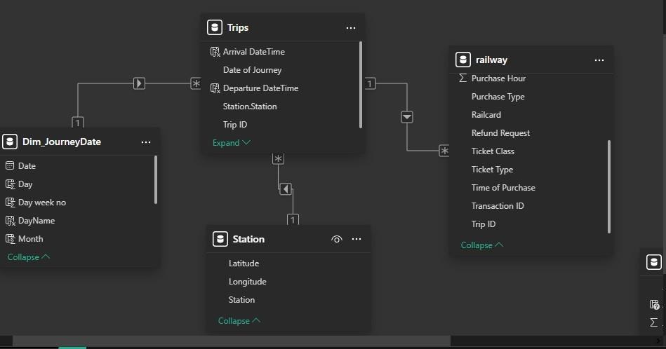
Normalization& Data Modeling

Slide 10
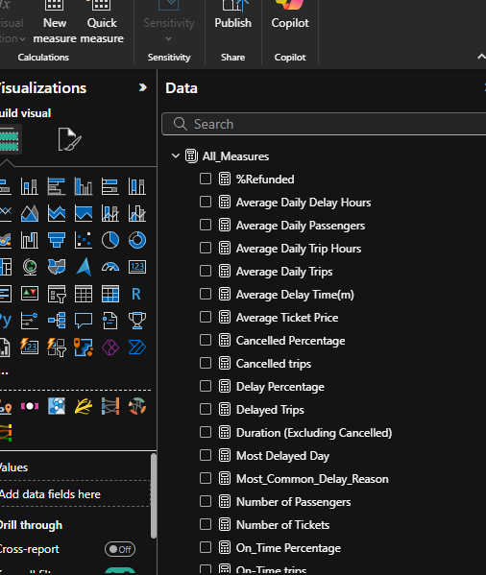

DAX

Slide 11
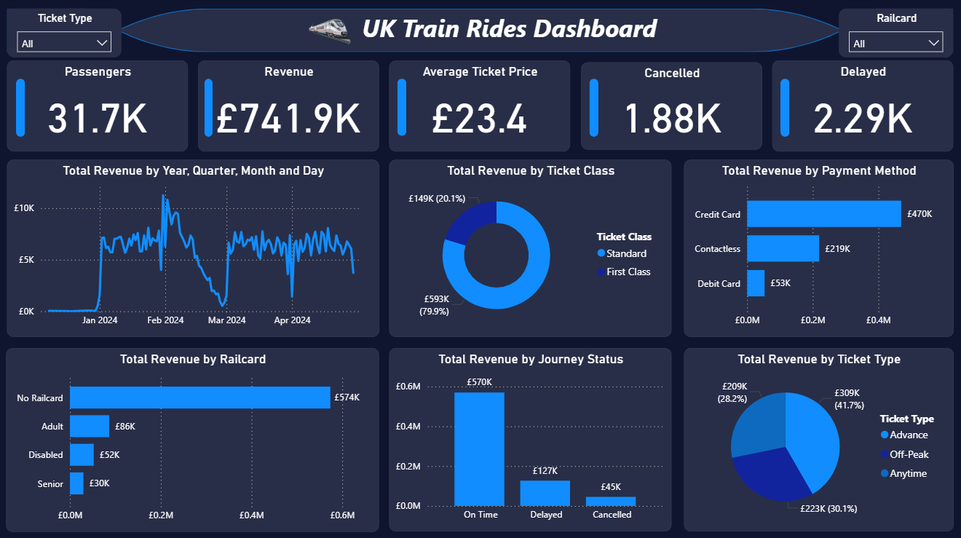
Visualization
Revenues

Slide 12
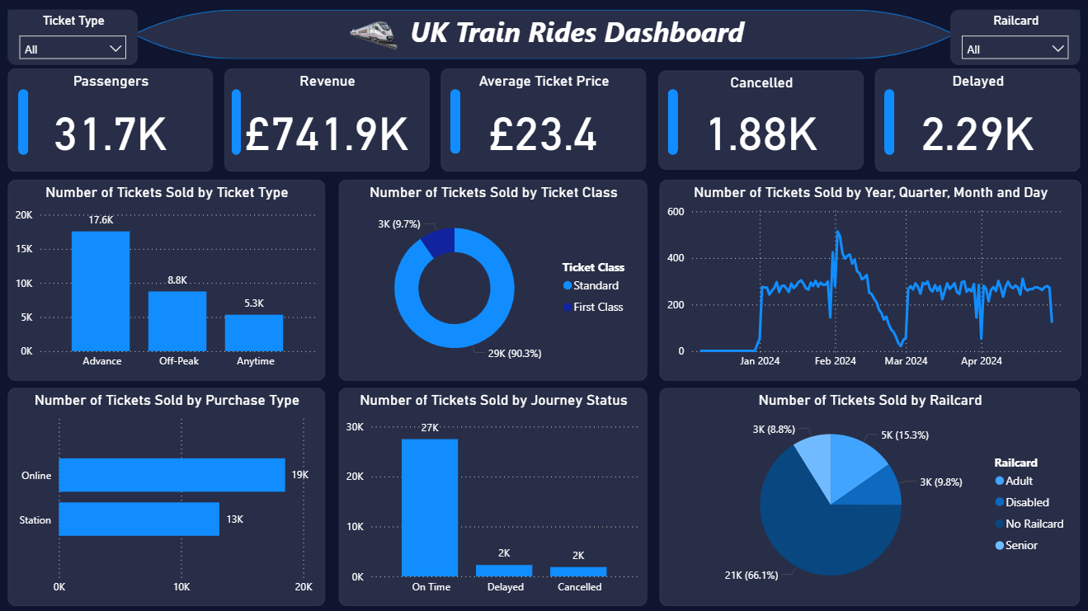
Visualization
Tickets

Slide 13
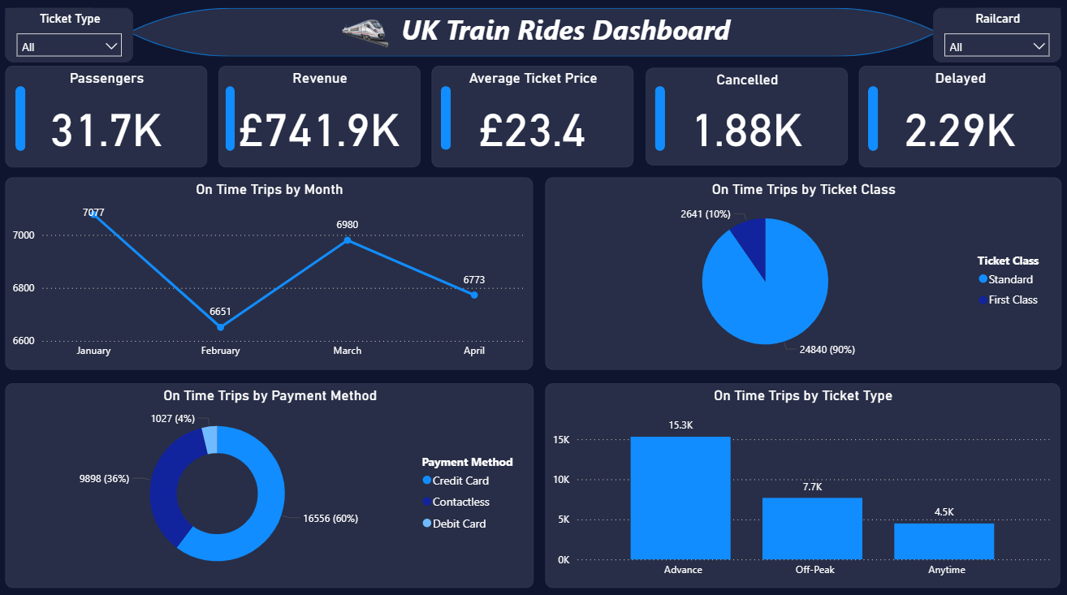
Visualization
On Time Trips

Slide 14
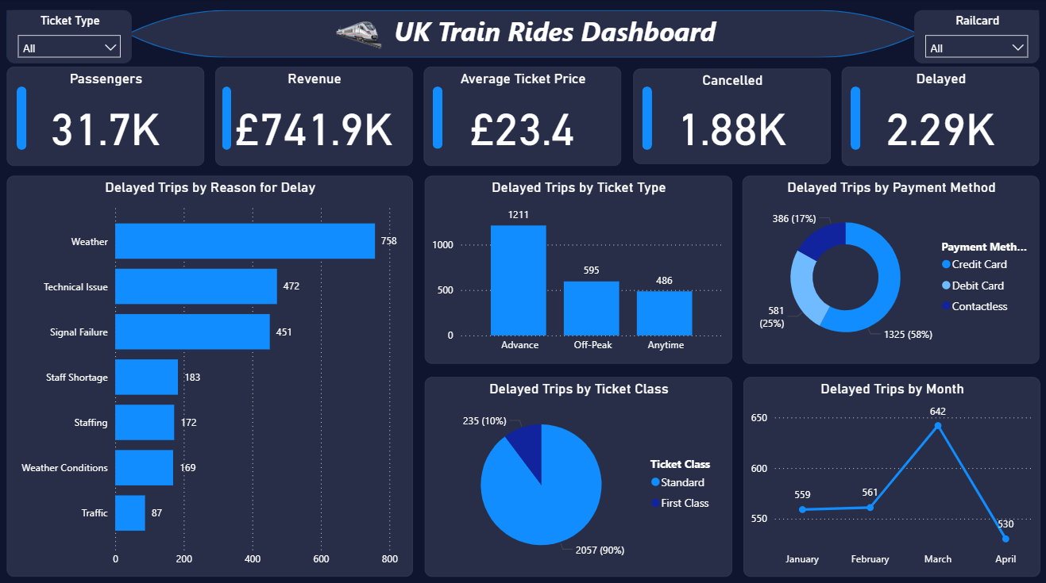
Visualization
Delayed Trips

Slide 15
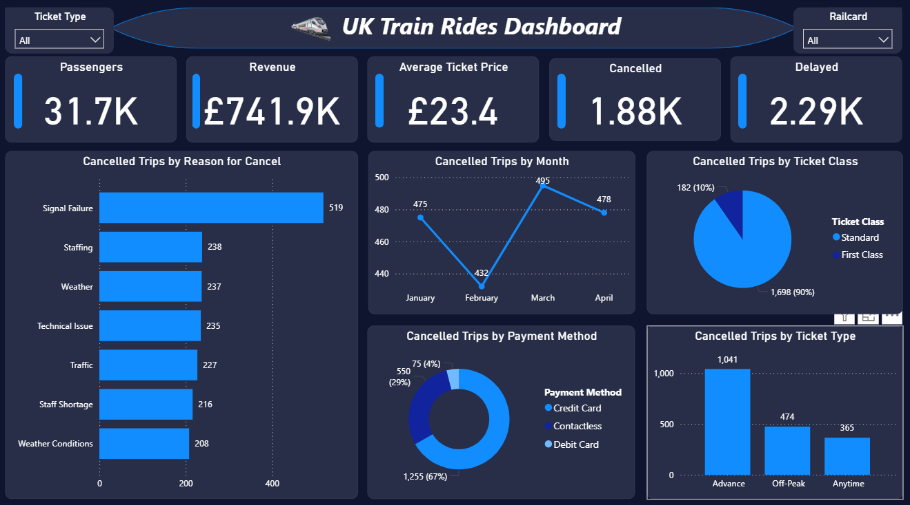
Visualization
Cancelled Trips

Slide 16

Conclusion& Recommendations
Priority Actions: Resolve signal failures and staff shortages to cut cancellations by 30% in 6 months.
Quick Wins: Introduce flexible pricing for off-peak travel and improve weather-related contingency plans.
Long-Term Strategy: Invest in infrastructure and workforce stability to boost punctuality beyond 90.7%.

Slide 17


